Slide 1
What’s the ontology of a Linked Dataset?
Nandana Mihindukulasooriya, Fadhela Kerdjoudj, Jose Luis Redondo, Alejandro Caparros
Tutor: Mathieu d’Aquin

Slide 2
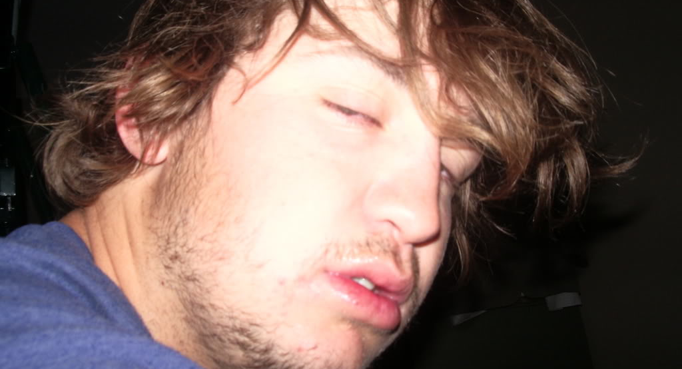
Problem

Slide 3
Problem
Diverse Datasets
Different domains
Different granularity, descriptiveness, in size
Absence of valid ontology
Harder to extract information

Slide 4
Objectives
Finding patterns in the data
Which information can be found?
Querying data with no prior knowledge of the vocabulary
Convert those patterns to ontological axioms
Enrich existing ontology
Build the ontology from the scratch
Ontology doesn’t exist / not formalized / not disclosed
Notes:
Exploring the datasets

Slide 5
What features are we interested in?
Classes
Class hierarchy
Properties
Range, Domain
Cardinalities
min, max, exact
qualified cardinalities
Universal quantifiers
Disjoint / equivalent / complement classes

Slide 6
Approach:
Calculate RelevantClasses
Check Properties per Class
Calculate Confidence
Cardinality

Slide 7

EventMedia¹ dataset
Events and media descriptions
LODE ontology and W3C Media Ontology
SPARQL endpoint
http://eventmedia.eurecom.fr/sparql
1 - http://datahub.io/dataset/event-media

Slide 8
Exploring the patterns
dul:Place
time:ProperInterval
dul:Place UNION p:Place
foaf:Agent
p:Place
e:atTime
e:atPlace
subClassOf
e:Event
min card 1
dc:title
dc: subject
foaf:Person
xsd:string
exact card 1
e:involvedAgent
xsd:string
subClassOf
foaf:Agent
reve:Teacher
foaf:Agent
reve:Teacher
foaf:Person`
Calculate RelevantClasses
Check Properties per Class
Notes:
Challenges – if the data doesn’t include types i.e. they are left to be inferred from the ontology

Slide 9
Confidence level
Calculate Confidence
PL – Number of triples matching the pattern
TL – Total Number of triples relevant to the pattern
As an indicator of how widely spread the pattern in the dataset
Configurable threshold for filtering the patterns

Slide 10
Example for the confidence level
Calculate Confidence
?x e:involvedAgent ?y → 290798
?x e:involvedAgent ?y . → 289150
?y a ?type
?x e:involvedAgent ?y . → 994
?y a reve:Teacher
0.0034
?x e:involvedAgent ?y . → 1008
?y a foaf:Person
0.0034
0.0049
1445
?x e:involvedAgent ?y . → 288142
?y a foaf:Agent
0.9908
289150
0.9943
TL

Slide 11
Weighted confidence level
Calculate Confidence
Two confidence levels
Direct confidence level (DCL)
Inherited confidence level (ICL)
Weighted confidence level
WCL = X DCL + Y ICL

Slide 12
Calculating Cardinality
Cardinality
Common patterns
Min cardinality zero
Max cardinality one
Exact cardinality one
Possible combinations
Min 0 Max 1
Min 0
Exact 1
Contradicting combinations
Min 0 Exact 1

Slide 13
Pattern groups
Cardinality
Related patterns grouped together
Eg. cardinality patterns
Different rules
Configurable pattern ranking / precedence
Predefined combinations

Slide 14
Implementation
Partially done:
Relevant classes, properties, and ranges.
Available at GitHub
https://github.com/acaparros/RdfToOwl

Slide 15
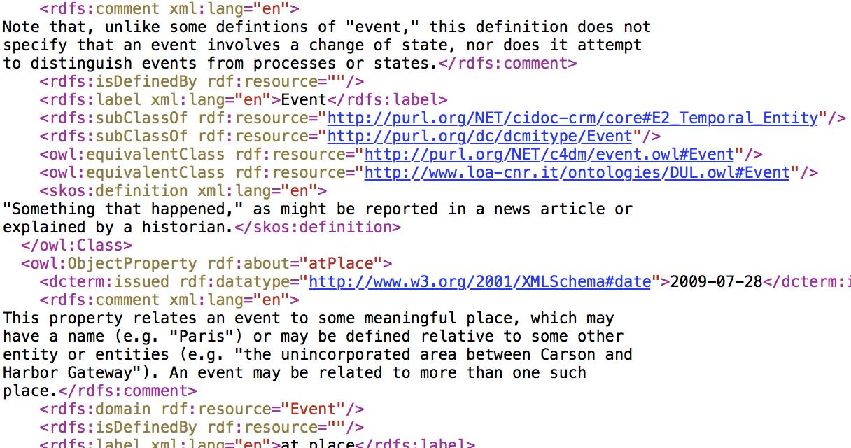
How to represent patterns ?
In OWL

Slide 16
Evaluation
Generated ontology (with some manual steps)
100% classes from referred in LODE ontology
properties
LODE Ontology
Generated Ontology
e:atPlace
e:atTime
e:inSpace
e:involved
e:involvedAgent
e:inSpace
dul:hasLocation
dul:hasRegion
e:isObserableAt
dc:title
dc:publisher
dc:description
dc:issued
dc:subject
e:hasCategory

Slide 17

LinkedMDB
2500
2500
movie:Writer
movie:Actor
Min 1 max n
Min 1 max n
db:movie:writer
db:movie:actor
2500
Min 1 max n
foaf:Person
Min 1 max n
movie:Film
movie:Genre
db:movie:actor
db:movie:genre
231
db:movie:director
Min 1 max 1
db:movie:relatedBook
movie:Director
min 0 max 1
movie:RelatedBook
2500
564
Notes:
Challenges – if the data doesn’t include types i.e. they are left to be inferred from the ontology

Slide 18
Evaluation:
No Ontology available
➔ No Evaluation possible
Restrictions accessing the Data:
Entity Count
Film 85.620
Actor 50.603
Director 17.156
Writer 17.335
Producer 14.882
Music Contributor 4.529
Cinematographer 3.263
Interlink 162.199
Some of the inferred patterns are then wrong:
- Min cardinality in (Film, Director) != 1
Notes:
Challenges – if the data doesn’t include types i.e. they are left to be inferred from the ontology

Slide 19
Future Work
More parameterization of the algorithms
Filter instances recent ontology version
Filter instances based on provenance information
Automatic comparison of the created ontology with the former one.

Slide 20
Related Work
Extracting core knowledge from Linked Data
Valentina Presutti, Lora Aroyo, Alessandro Adamou, Balthasar Schopman, Aldo Gangemi, and Guus Schreiber
Combining Data Mining and Ontology Engineering to enrich Ontologies and Linked Data
Mathieu d’Aquin, Gabriel Kronbergerb, and Mari Carmen Suárez-Figueroac
Ontology Learning from Open Linked Data and Web Snippets
Ilaria Tiddi, Nesrine Ben Mustapha, Yves Vanrompay, and Marie-Aude Aufaure
Ontology Design Pattern Language Expressivity Requirements
Matthew Horridge, Mikel Ega~na Aranguren, Jonathan Mortensen, Mark Musen and Natalya F. Noy
Comparing Ontologies — Similarity Measures and a Comparison Study
Alexander Maedche and Steffen Staab
Semantic diff as the basis for knowledge base versioning
Enrico Franconi , Thomas Meyer , Ivan Varzinczak

